Slide 1
DASK & LUIGI
AN EFFICIENT PIPELINE
BY: MOHAMED ELSALMI

Slide 2
Introduction
Working in the healthcare industry, I was approached by the Billing department to compile a weekly report of cases that they need to follow up on according to certain parameters.
Considering, the immense size of the data, Dask seems to be a viable option to work with the data and to perform data cleanup/analysis.
Due to the nature of my field, data is highly confidential and extremely sensitive – therefore, mock datasets were used, which are far smaller in size, however they resemble the actual datasets being used almost exactly.

Slide 3
Introduction (contd.)
As we are migrating to storing all of our data to the cloud, a proper framework needs to be drawn up to facilitate data collection, clean up and analysis. Instead of going for a BI tool, such as Incorta or Microsoft BI, I set out to utilize the tools used in this course in order to better handle the vast size of data available.
Using Luigi, a dedicated pipeline was built in order to facilitate reports that need to be created for the billing department. Afterwards several tools were used in order to utilize dask to read in the data.

Slide 4
Objectives
Collect Data
Clean Up Data
Merge Billing Data and Fair Health Data
Build a simple Linear Regression Model
I will be using Dask and Luigi to perform all of the aforementioned tasks.

Slide 5
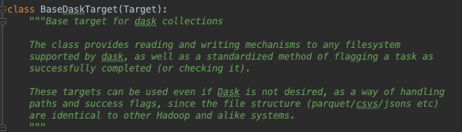
DaskTarget
Utilizing the DaskTarget class that we created for PSET 5, I set up a Luigi pipeline that also incorporates a salted output to rerun the appropriate tasks to rerun when data dependencies and/or task definitions are modified.

Slide 6

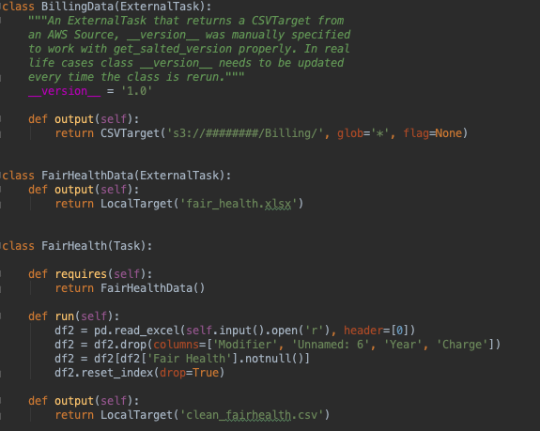
Data Collection
An ExternalTask was created to collect the data from AWS, another file called fair_health.xlsx is also collected. The fair health excel file has updated pricing for different tests according to their geographical location of the facility.
The objective is to link the fair health price to our billing data using the CPT Code. CPT codes are by definition:
“Current Procedural Terminology (CPT) is a medical code set that is used to report medical, surgical, and diagnostic procedures and services to entities such as physicians, health insurance companies and accreditation organizations.”

Slide 7
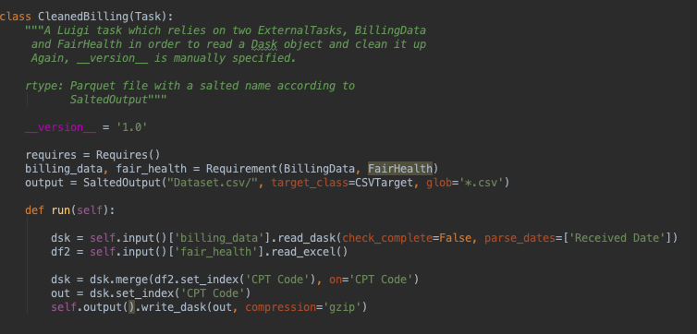
Data Cleanup
After the ExternalTasks are run, Dask Targets are returned and the data is cleaned up, and the two datasets are merged together, leaving out unnecessary columns.

Slide 8
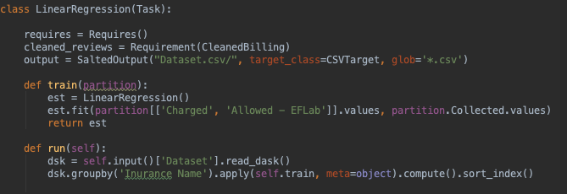
Machine Learning
After the data is collected, cleaned up and merged it goes through a linear regression model in order to perform some analysis on the cleaned dataset and perhaps come up with KPI’s for the following quarters.

Slide 9
Thank you Mohamed ElSalmi

